Slide 1

Airline Safety
Cameron Pick

Slide 2
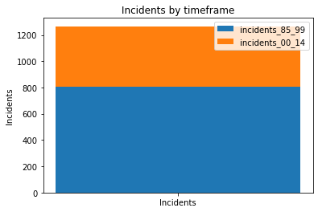
The bar graph bots a decrease in accidents from 85-99 to 00-14.

Slide 3
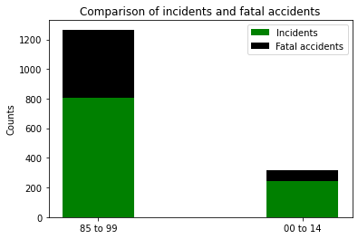
Out of those incidents, fatal accidents make a small percentage.

Slide 4
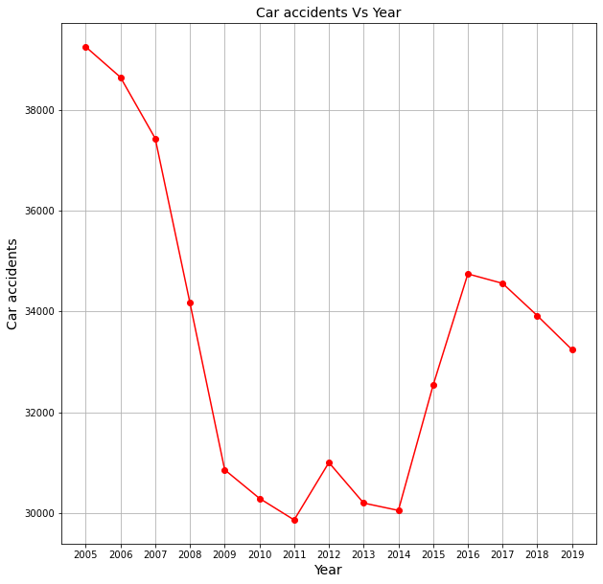
Car accidents, on other hand, much larger and continue to be high verses airline

Slide 5
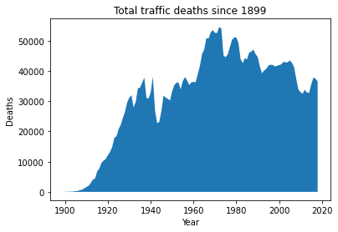
Traffic deaths have grown larger over the yearsand stayed higher

Slide 6
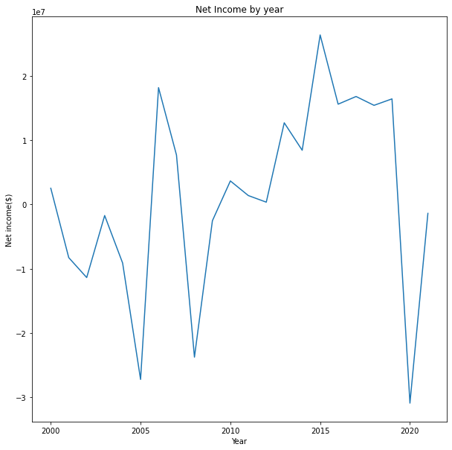
Total net income over the years across airlines.

Slide 7
Questions?
https://github.com/cameronpick1/Projects.git

